Slide 1
Unit 2- Lecture 17
Introduction to Game playing
Board games

Slide 2
Introduction to Game playing
Playing games like Chess well has long been considered a hallmark of intelligence amongst humans.
The game of Chess was most likely invented in India, and has long been considered as a training ground for strategic thinking.
Chess requires strategic and tactical skills, and in countries like the erstwhile USSR, it was actively promoted to help develop analytic skills.
The computer science community quickly took up games from the earliest times.
The first paper on computer chess was published by Claude Shannon.
The first dramatic success in implementing games came, however, in checkers.

Slide 3
In the Dartmouth Conference where the term Al was coined in 1956, one of the big exhibits was Arthur Samuel's checkers playing program.
The striking feature of Samuel's Checkers program,1959 was that it learnt from experience, and grew better and better at the game, eventually defeating Samuel himself.
In 1968, the British grandmaster David Levy had wagered a bet that no machine could beat him in Chess.
The duration of the bet, fortunately for Levy, was 10 years.
In 1989, Levy was soundly beaten by the computer program Deep Thought in an exhibition match.
Computer programs improved steadily in performance, and by the mid-nineties were of world championship caliber.

Slide 4
In 1996, IBM's Deep Blue did achieve the feat of beating world champion Garry Kasparov, and in the following year beat him 3.5-2.5 in a six match series.
But no one has yet bestowed the quality of intelligence upon computers because of that!
Apart from the attraction that humans naturally have for games, they are very good as platforms for experimentation.
Games provide a well defined environment in which states are intrinsically discrete.
This means that one does not have to worry about processing input or effecting output in a complex environment, and can focus entirely on the decision making strategy.

Slide 5
One can avoid perception and action in the real world; problems that one would have to address if one were building a robot to play golf or tennis.
Moreover, absolutely nothing is lost in abstraction.
Furthermore, in games, the rules are well defined and success or failure can be measured easily.
Good programs will beat inferior programs or humans in the game.
Moreover, in spite of the simplicity of the domain, they provide us with problems that are hard to solve.
Game playing is also interesting because it allows us to reason about multi-agent activity.

Slide 6
The problem-solving activity studied in the preceding chapters is characterized by the fact that only a single agent is involved.
Single agent situations do occur in the real world.
For example, organizations can be seen as agents pursuing their goals in isolation.
They could be in industrial organizations planning their design and manufacturing of products, or they could be government organizations planning infrastructure, or sending a man to the moon, or a rover to Mars Or an individual may be planning a meal, or building a house.
Many real world situations, have multiple agents involved. In such situations, the problem-solving agents have to consider the actions of the other agents too, because they affect the world the agent is operating in.

Slide 7
The agents may be collaborating with each other, they may be competing with each other, or they may be opposite to each other.
Interaction between agents has most commonly been studied by abstracting them as games.
Games are formalisms that are used in various fields of study, ranging from economics to war.
The common feature is that they attempt to devise models of rationality in the face of other agents being active.
John von Neumann, the prolific computer scientist, is also credited with pioneering work in formalizing games and is often referred to as the father of Game Theory.

Slide 8
Board games
The games focused in this unit are classified as:
• two person,
• zero sum,
• complete information,
• alternate move, and
• deterministic games.
Two person games have exactly two players.
In zero sum games, the total payoff is zero.
One player's gain is the other player's loss.
One wins, the other loses.
In complete information games, both the players have access to all the information.

Slide 9
That is, both can see the board, and thus know the options the other player has.
In alternate move games, the players take turns to make their moves.
In deterministic games, there is no element of chance in the moves that one can make.
All the above properties can be relaxed to produce more complex multi-agent environments.
Adding a dice to a board game introduces an element of chance.
The player cannot deterministically make a move.
The essential feature of most card games is that they are multiple-player incomplete information games.

Slide 10
Cards of other players are hidden, but the pack is known and finite.
So a player does not know the options available to other players, but the possible options are bounded by knowledge of the cards that have not yet been played.
In games like contract bridge, players draw inferences from the known information to collect as much additional information as possible.
The game has four players, with partnerships of two each, and the strategy also involves communication of information between partners.
Since this information is also available to opponents, the tactics often involve misinformation and fraud too.

Slide 11
Army generals fighting wars operate similarly with genuinely incomplete information.
They also attempt to collect information about the resources and options of the enemy, and likewise the flow of information yields opportunities of misinformation and fraud.
War and spies provide a multitude of engaging stories concerning information exchange and deception.
Since both sides usually suffer casualties, wars can be seen as negative sum games, though sometimes one side may have some positive payoff.
A price war, likewise, inflicts losses on the competing sellers, and can be modeled as a negative sum game, though if the buyers are included in the game too then it becomes a multi-player zero sum game.

Slide 12
Cooperation is an example of a positive sum game, whether it is between students studying together for an examination, or when large corporations plan to jack up prices.
Observe that some of the examples above do not have alternating moves, and neither is the outcome of their actions deterministic.
In the domain of recreation, Checkers (also known as Draughts), Chess, Othello and Go are examples of board games that have received the attention of programmers.
One of the earliest to make a mark was Arthur Samuel's Checkers playing program.
It was a program that improved its performance with experience, and became news when it was able to beat its creator!

Slide 13
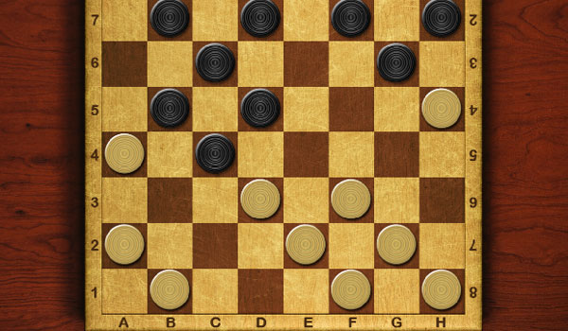
Checkers

Slide 14
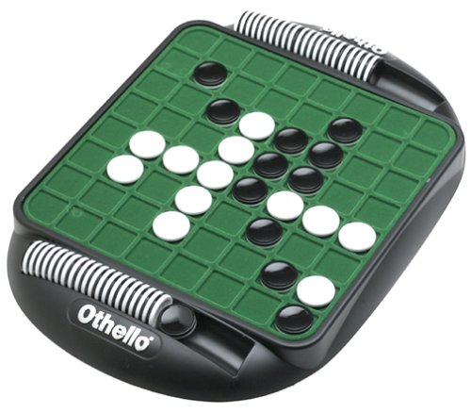
Othello

Slide 15
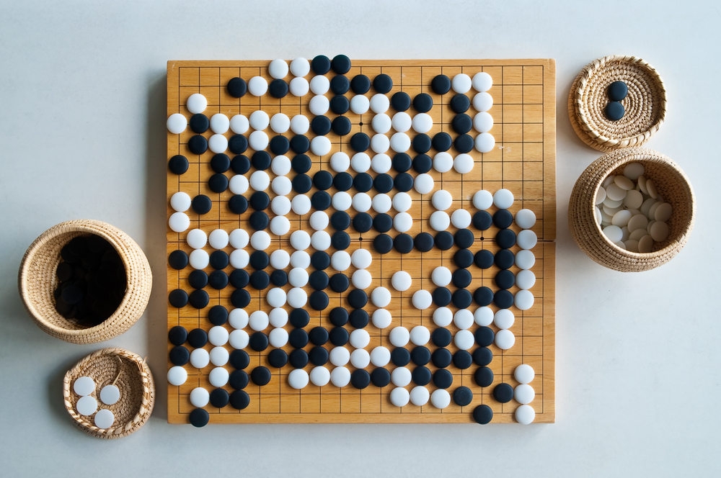
Go

Slide 16
The learning it did was essentially parametric reinforcement learning, tuning weights of its evaluation function based on the outcome of each game.
But it contributed to the wild notion of computers taking over the world, a la Victor Frankenstein's robotic creature, in the novel written by Mary Shelley in 1818.
Amongst the incomplete information games, the most successful has been the implementation of Scrabble (Scrabble is a word game in which two to four players score points by placing tiles bearing a single letter onto a board divided into a 15×15 grid of squares).
In fact, the program Maven, ( AI scrabble player ) can easily outplay human players (Sheppard, 2002).
This is not surprising given that the machine can have access to a large vocabulary.

Slide 17
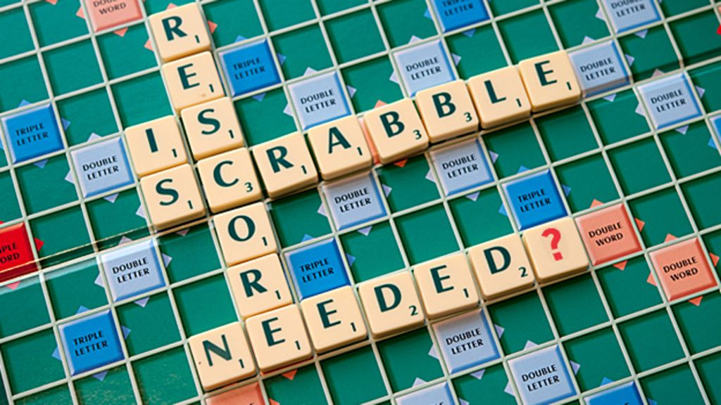
Scrabble

Slide 18
In addition, it can speedily run through different combinations, and pick the one yielding maximum score.
One could use a heuristic function that evaluates a board position by the points it yields, along with some measure of the cost of openings it creates for the opponent.
A game that is met with less success is Contract Bridge.
Though there have been several attempts at implementing the game, a truly world class player is yet to emerge.

